Slide 1
PGR Jan 30: What’s new with CO₂ Clinical Epidemiology of Hypercapnic Respiratory Failure
Presenter: Brian W Locke MS MSCI
Assistant Professor of Clinical Investigation
Pulmonary and Critical Care
Intermountain Medical Center
COI: MTN, time-series machine learning on continuous sensor data.
Funding:
American Thoracic Society Academic Sleep Pulmonary Integrated Research/Clinical Fellowship
NIH NHLBI T32 U of U PCCM
Intermountain Fund PCCM Seed Grant: Follow-Up Needs after Discharge with Hypercapnia (FUND-Hypercapnia)
To be reviewed K23: Bioinformatics Tools to Quantify the Disease Burden Associated with Hypercapnia

Slide 2
Overarching hypothesis
Advice: ‘study what makes you mad’
The inpatient to outpatient care transition for patients with hypercapnic respiratory failure is horrible.
I suspect we’d achieve better outcomes by
systematically identifying patients with hypercapnia
Establishing an evidence base for undifferentiated ventilatory failure
consistently implementing measures to mitigate their risks.

Slide 3

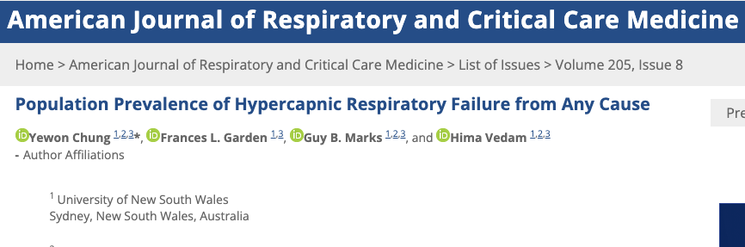
Background: Hypercapnic Respiratory Failure
Population-standardized prevalence PaCO2 > 45 mmHg after excluding iatrogenic causes:
150* per 100,000 person/year
Common contributors to Hypercapnic Respiratory Failure:
Advanced Age
Opiate Use
Obesity
Advanced Lung Dz
Multimorbidity
Inpatient ICD code for Hypercapnic Respiratory Failure
23% 30d readmission rate
Same as CHF, more than MI
Usually (66%) with recurrent hypercapnia
Notes:
[ ] todo: Simplify

Slide 4
Hypercapnia Projects
Hypercapnic Respiratory Failure Diagnostic Workups in Utah
Racial inequity in diagnosis?
Case definitions for hypercapnia are inconsistent
Methods of identification: TcCO2 and machine learning.

Slide 5
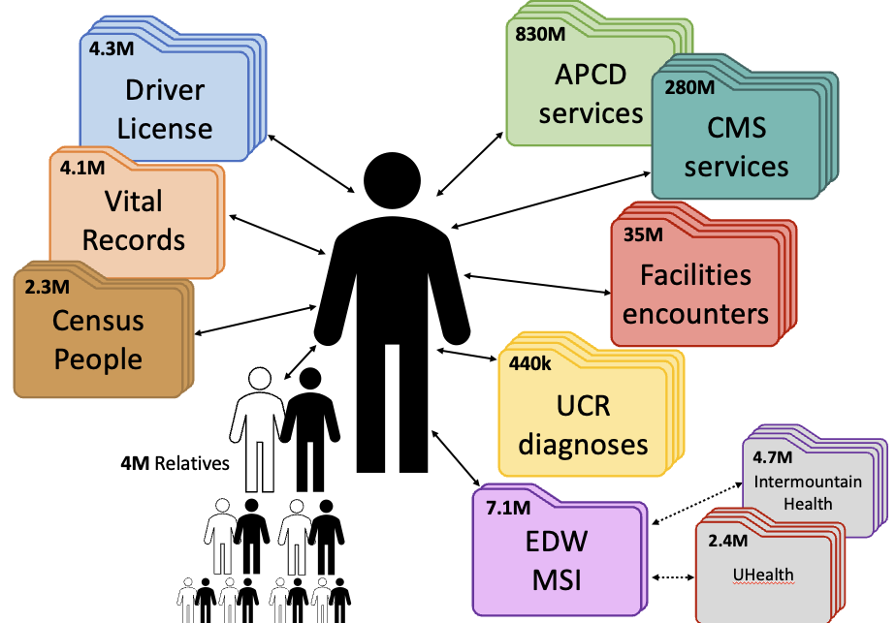
Utah Population Database

Slide 6
All Payor Claims Data Utah licensed payers and Medicaid report information on their members’ eligibilities and paid medical and pharmacy claims. Pre-research request: summary-level data (600$+150/hr)
ICD-10-CM Codes for Hypercapnic Respiratory Failure
J96.02: Acute Respiratory Failure with Hypercapnia
J96.12: Chronic Respiratory Failure with Hypercapnia
J96.22: Acute and Chronic Respiratory Failure with Hypercapnia
J96.92: Respiratory Failure, unspecified with Hypercapnia
E66.2, Obesity with Hypoventilation
Table 1: Extrapolated hypercapnic respiratory failure 1-yr period-prevalence by diagnosis codes in UT
Year | Hypercapnia Diagnosis (per 100k persons)
2016 | 133.5
2017 | 132.2
2018 | 143.3
2019 | 147.6
Utah | 2016 count | 2017 count | 2018 count | 2019 count
Any Diagnosis | 4064 | 4104 | 4520 | 4728

Slide 7
How hypercapnic respiratory failure occurs
Hypothesis
Diagnosed with a cause of hypercapnic respiratory failure
Disease worsens
Present with Hypercapnic Respiratory Failure
Implied
Apply relevant guideline:
CHEST 2023 NMD
ATS 2021 Hypercap. COPD
ATS 2019 OHS
Presents with undifferentiated hypercapnic respiratory failure
Gets TTE, CT Chest. Referral for PFTs, HSAT
Establish which condition(s) contributed
Reality
What workup and management is indicated?

Slide 8
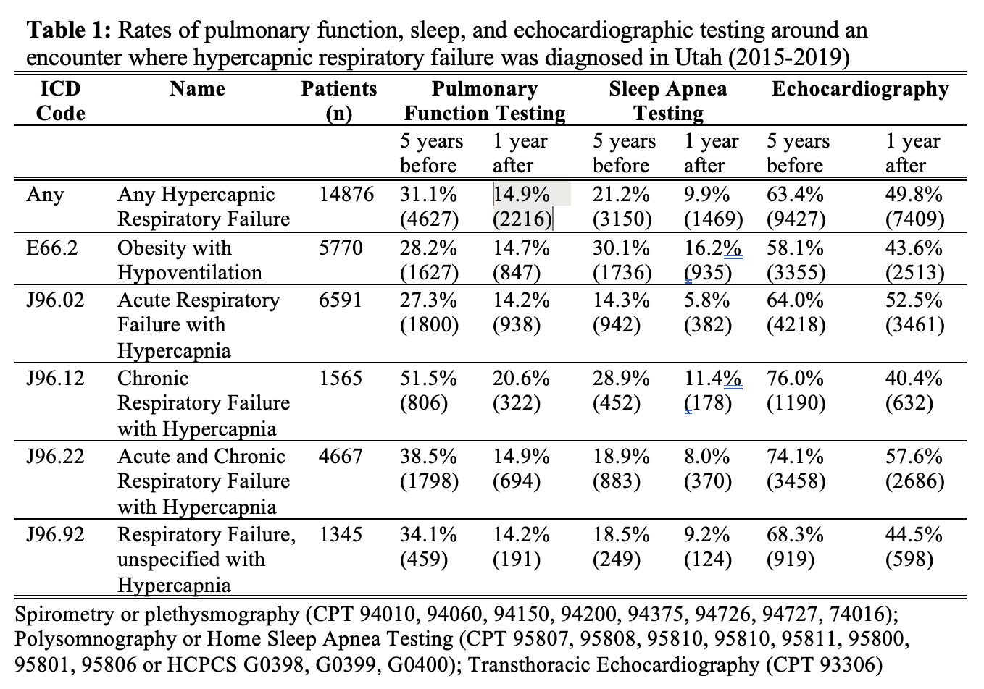

Slide 9
Next Steps:
Individual patient data is in regulatory approval
Recreate pre-research analysis, with additional covariates and outcomes
Covariates: prior diagnoses, demographics
Mediators: DME orders, Medication Fills, Specialist Referrals, Diagnostic Testing
Outcomes: Presentation to ED/Urgent, Re-hospitalization, Mortality
Linkage to Intermountain Health:
cohort creation with lab data (ABG, VBG, Diagnostic Modeling)

Slide 10
Differences in the Diagnosis of Hypercapnic Respiratory Failure by Race and Ethnicity
Diagnosis disparities in hypoxemic respiratory failure are well documented; less is known about hypercapnic respiratory failure
Hypothesis: the method of diagnosis (ABG, VBG, or both) of hypercapnic respiratory failure differs between race/ethnicities, which has implications for treatment (device) qualifications
TriNetX (aggregated health records from 76 hospitals in the United States)
Adult encounters occurring between January 1 and December 31, 2022
Ambulatory, emergency department, and hospitalized patients
Non-missing race/ethnicity information

Slide 11
Analysis
1°: Among patients who receive a diagnosis code for hypercapnic respiratory failure based on day-1 evidence,
Multinomial logistic regression, 3-outcomes ABG PaCO₂ ≥ 45 mmHg only, VBG PCO₂ ≥ 50 mmHg only, or ABG & VBG
adjust for the type of encounter (ambulatory, emergency, inpatient), age, sex, and region of the U.S. (West, Midwest, South, or Northeast)
2°: Why?
Difference in propensity for ABG?
Different severity of disease?
Different propensity to label as Hypercapnia?

Slide 12
Main result
Day-1 Hypercapnia Evidence | Estimate | Non-Hispanic White | Non-Hispanic Black | Hispanic/ Latino | Non-Hispanic Asian | Non-Hispanic AI/AN | Non-Hispanic NH/PI
ABG only | Unadjusted | 7,857 (54.4%) | 1,579 (45.9%) | 488 (45.2%) | 160 (50.8%) | 51 (38%) | 23 (85%)
ABG and VBG | Unadjusted | 4,189 (29.0%) | 1080 (31.4%) | 381 (35.3%) | 104 (33.0%) | 62 (47%) | 1 (4%)
VBG only | Unadjusted | 2,410 (16.7%) | 784 (22.8%) | 210 (19.5%) | 51 (16.2%) | 20 (15%) | 3 (11%)
 | Odds Ratio (Adjusted) | 1.0 (Ref) | 1.76 [1.60-1.94] | 1.04 [0.88-1.23] | 1.03 [0.75-1.39] | 0.8 [0.5-1.3] | 0.7 [0.2-2.3]
 | Average Marginal Effect (Adjusted) | 0 (Ref) | 8.8% [7.2% to 10.5%] | 0.5% [-1.7% to 2.8%] | 0.3% [-3.8% to 4.5%] | -3% [-9% to 3%] | -4.4% [-17% to 8%]

Slide 13
Why?
Propensity for ABG & VBG | Different disease severity | Propensity for ICD label | CO₂
Logistic GEE (encounter type, region, age, sex, cat. BMI) | Distribution of PCO2 | ABG, VBG Density Plot | Logistic GEE (enctounter type, region, PCO2-spline, HCO3-spline)

Slide 14
Why?
Propensity for ABG & VBG | Different disease severity | Propensity for ICD label | CO₂
Logistic GEE (encounter type, region, age, sex, cat. BMI) | Distribution of PCO2 | ABG, VBG Density Plot | Logistic GEE (encounter type, region, PCO2-spline, HCO3-spline)

Slide 15
Why?
Propensity for ABG & VBG | Different disease severity | Propensity for ICD label | CO₂
Logistic GEE (encounter type, region, age, sex, cat. BMI) | Distribution of PCO2 | ABG, VBG Density Plot | Logistic GEE (encounter type, region, PCO2-spline, HCO3-spline)

Slide 16
Limitations
Inability to account for hospital- and provider- level behavior
Unable to control for all relevant confounders (eg disease severity)
potential for incomplete ascertainment of outcomes.
Difference in diagnosis vs Disparity in diagnosis?
Does this translate to downstream consequences?
Maybe VBG diagnosis is a good thing and device qualifications need to change?

Slide 17
Take home points
Study Question: Are minoritized patients more likely to be diagnosed with hypercapnic respiratory failure on VBG-only evidence?
Results: In nationwide aggregated health record data, Black patients with hypercapnic respiratory failure were 8.8% (7.2-10.5%) more likely to be diagnosed with VBG-only evidence. This may result from differing propensities to undergo VBG (higher) and ABG (lower) sampling, rather than differences in disease severity or diagnostic labeling.
Interpretation: Where therapeutic interventions rely on results from arterial sampling (e.g. home NIV), Black patients may be at increased risk for lower-quality care.

Slide 18
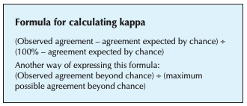
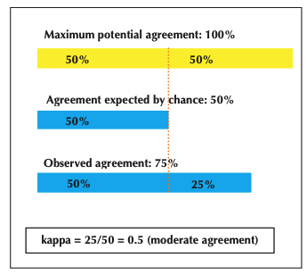
The Consistency of Hypercapnic Respiratory Failure Case Definitions in Electronic Health Record Data
Hypothesis: case definitions in use identify importantly different patients
Literature Review | Emulation Dataset
Literature reviews of studies of any-cause hypercapnia | Assess overlap of the case definitions in TriNetX database
15 studies using 13 case definitions to identify patients with hypercapnia. 3 included elements that couldn’t be emulated in EHR data (screen ABG, NIV on d/c, consultation) | N=445,686 U.S. adults from 76 institutions who had at least one characteristic that should make a reasonable clinician suspect hypercapnia may be present during 2022
Cohen’s kappa (κ, agreement beyond chance)

Slide 19
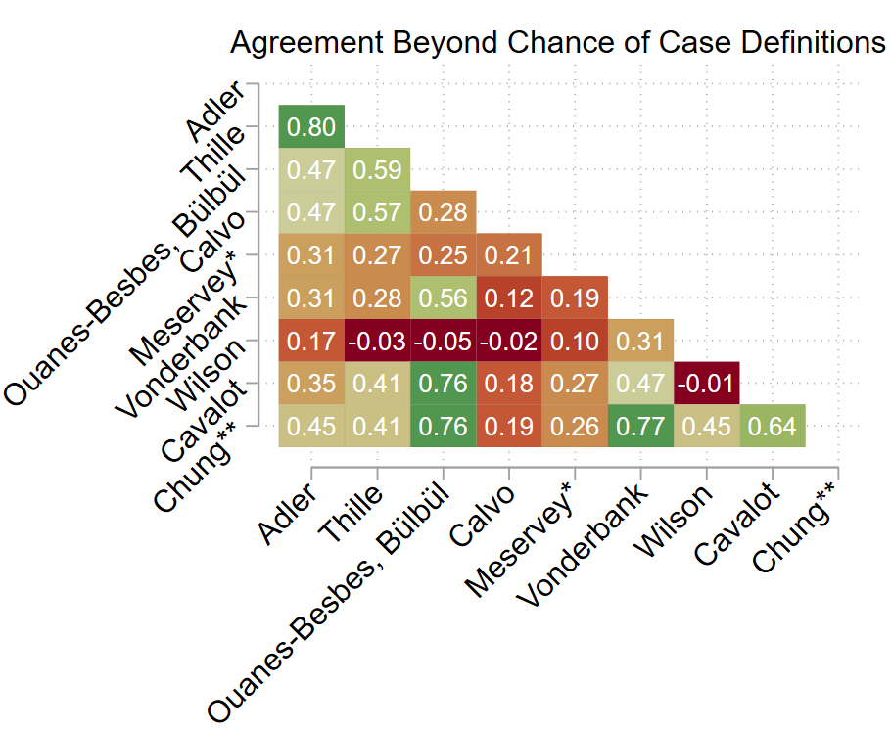
Case Definitions for Hypercapnic Resp Failure
 | Case Definition
Adler | PaCO₂ ≥ 47.25 mmHg and either NIV or IMV procedure code
Thille | PaCO₂ ≥ 45 mmHg, arterial pH < 7.35, and either NIV or IMV procedure code
Ouanes-Besbes | PaCO₂ ≥ 45 mmHg and pH < 7.35
Calvo | PaCO₂ > 45 mmHg, arterial pH < 7.35 and a NIV procedure code
Bulbul | CO₂ ≥ 45 mmHg and pH < 7.45
Meservey | Any diagnosis code for Hypercapnic Respiratory Failure*
Vonderbank | Either a PaCO₂ ≥ 45 mmHg or venous CO₂ ≥ 45 mmHg and venous pH > 7.35
Wilson | PaCO₂ ≥ 50 mmHg and pH 7.35-7.45
Cavalot | Either PaCO₂ ≥ 45 mmHg and arterial pH ≤ 7.35, or venous CO₂ ≥ 50 mmHg and venous pH ≤ 7.34
Chung | PaCO₂ ≥ 45 mmHg and pH ≤ 7.45
Median κ = 0.35

Slide 20
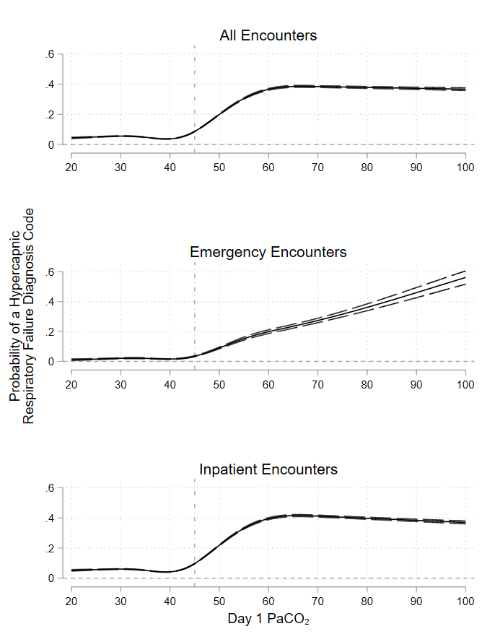
Why do the case definitions identify different patients?
Some difference in target population*
Sensitivity of diagnosis codes is low →
Restricted cubic splines
Method of testing differs (ABG, VBG)

Slide 21
Why do the case definitions identify different patients?
 | Entire Enriched Cohort | Only ABG obtained (first day) | Only VBG obtained (first day) | Both ABG and VBG obtained (first day)
 | N=515,286 | N=132,193 | N=94,614 | N=55,049
Setting
Emergency encounter | 33% (171,814) | 16% (21,455) | 42% (39,816) | 14% (7,580)
Inpatient encounter | 67% (343,559) | 84% (110,744) | 58% (54,857) | 86% (47,484)
Critical care billed | 23% (118,143) | 36% (47,636) | 21% (19,528) | 48% (26,528)
US region
South | 47% (242,266) | 65% (85,849) | 30% (27,918) | 32% (17,574)
Northeast | 25% (129,446) | 14% (18,937) | 49% (46,609) | 31% (17,300)
Midwest | 7% (38,471) | 8% (10,013) | 9% (8,046) | 10% (5,534)
West | 20% (105,103) | 13% (17,394) | 13% (12,041) | 27% (14,641)
Proportion of patients from the enriched sample identified by each case definition
Adler | 4% (18,118) | 8% (10,602) | 0% (0) | 14% (7,516)
Thille | 3% (16,263) | 7% (9,790) | 0% (0) | 12% (6,473)
Ouanes-Besbes & Bülbül | 7% (37,336) | 20% (25,812) | 0% (0) | 21% (11,524)
Calvo | 1% (6,566) | 3% (4,094) | 0% (0) | 4% (2,472)
Meservey | 6% (29,009) | 8% (11,080) | 4% (4,032) | 17% (9,196)
Vonderbank | 17% (86,137) | 31% (40,411) | 26% (24,267) | 39% (21,459)
Wilson | 4% (18,118) | 10% (13,113) | 0% (0) | 9% (5,005)
Cavalot | 11% (58,481) | 21% (27,264) | 13% (12,555) | 34% (18,662)
Chung | 11% (57,813) | 31% (40,411) | 0% (0) | 32% (17,402)

Slide 22
The case definitions identify different patients
 | Case Definition | n= | Female | Black | HCO3- | PaCO₂ | Death (2-mo)
Adler | PaCO₂ ≥ 47.25 mmHg and either NIV or IMV procedure code | 18,118 | 44% | 16% | 26.6 (±7.3) | 66.5 (±23.7) | 28%
Thille | PaCO₂ ≥ 45 mmHg, arterial pH < 7.35, and either NIV or IMV procedure code | 16,263 | 42% | 16% | 24.8 (±6.8) | 63.8 (±21.7) | 28%
Ouanes-Besbes | PaCO₂ ≥ 45 mmHg and pH < 7.35 | 37,336 | 46% | 14% | 24.8 (±5.9) | 60.2 (±19.6) | 18%
Calvo | PaCO₂ > 45 mmHg, arterial pH < 7.35 and a NIV procedure code | 6,556 | 50% | 17% | 27.8 (±6.7) | 64.7 (±16.5) | 20%
Bulbul | CO₂ ≥ 45 mmHg and pH < 7.45 | 38,504 | 47% | 14% | 25.8 (±5.9) | 62.7 (±16.5) | 20%
Meservey | Any diagnosis code for Hypercapnic Respiratory Failure* | 29,009 | 50% | 17% | 27.1 (±7.4) | 55.1 (±19.5) | 21%
Vonderbank | Either a PaCO₂ ≥ 45 mmHg or venous CO₂ ≥ 45 mmHg and venous pH > 7.35 | 86,137 | 47% | 16% | 26.5 (±5.5) | 57.1 (±20.4) | 13%
Wilson | PaCO₂ ≥ 50 mmHg and pH 7.35-7.45 | 18,118 | 48% | 13% | 28.6 (±5.1) | 54.9 (±20.3) | 12%
Cavalot | Either PaCO₂ ≥ 45 mmHg and arterial pH ≤ 7.35, or venous CO₂ ≥ 50 mmHg and venous pH ≤ 7.34 | 58,481 | 45% | 17% | 24.8 (±5.9) | 56.8 (±20.1) | 17%
Chung | PaCO₂ ≥ 45 mmHg and pH ≤ 7.45 | 58.813 | 47% | 14% | 26.3 (±6.1) | 58.5 (±20.4) | 16%

Slide 23
Take-Home Points
Study Question: Do the case definitions for hypercapnic respiratory failure in health record data identify the same, or similar, patients?
Results: Applying ten case-definitions from the published literature to a large, aggregated nationwide dataset of health records identified different patients (median kappa of 0.35) who had widely variable characteristics and outcomes.
Interpretation: Case definitions for identifying hypercapnic respiratory failure in health record data create substantively different cohorts, which hampers the synthesis of research findings.

Slide 24
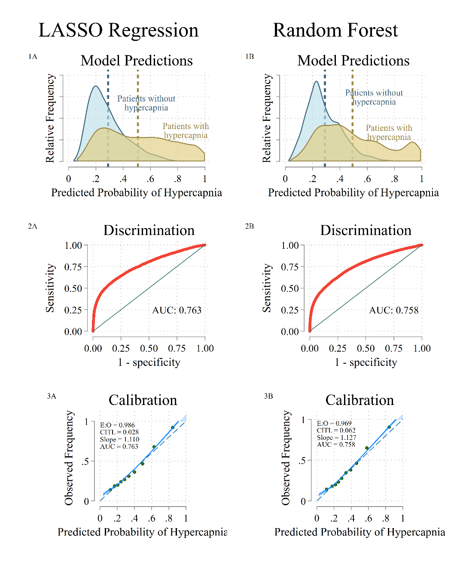
How could we diagnose hypercapnic RF?
West | Midwest | South | Northeast
Training | Validation | Training | Training
n = 16,277 | n = 20,837 | n = 70,921 | n = 23,816
Analysis |  | Patients | Model |  | Discrim. |  |  | Calibration |  |  | Overall
 |  |  |  |  |  | AUC | E:O |  | CITL | CS |  | Brier Score
Primary |  | ABG |  | LASSO |  | 0.763 | 0.986 |  | 0.028 | 1.110 |  | 0.180
 |  |  |  | RF |  | 0.758 | 0.969 |  | 0.062 | 1.127 |  | 0.184
Silver Standard |  | ABG or VBG |  | LASSO |  | 0.749 | 0.925 |  | 0.156 | 1.098 |  | 0.190
 |  |  |  | RF |  | 0.745 | 0.912 |  | 0.180 | 1.190 |  | 0.193
Inverse Probability Weighted |  | ABG (weighted to full sample) |  | LASSO |  | 0.792 | 0.982 |  | 0.041 | 1.227 |  | 0.178
 |  |  |  | RF |  | 0.782 | 0.957 |  | 0.094 | 1.251 |  | 0.184

Slide 25
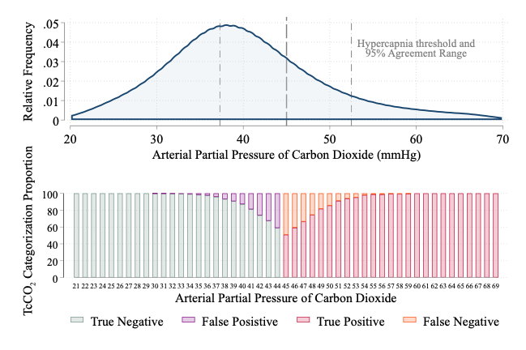
How could we diagnose hypercapnic RF?
SRMA of TcCO₂-PaCO₂ Agreement studies
7021 paired measurements from 2817 participants in 73 studies
Mean bias: 0.09 mmHg lower
Pop. Std. dev. (within- and between- study variance): 4.6 mmHg
Simulate estimates for all 158k TriNetX patients w/ ABG in 2022:
Sens: 84.2%
Spec: 91.0%,
NPV: 93.0% @ 30.3% prev.
PPV: 80.4%. @ 30.3% prev
Next: Context specific estimates
Validation amongst no-ABG pts.

Slide 26
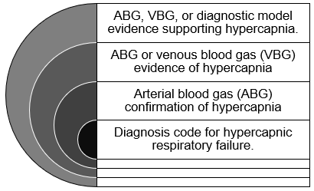
Next Steps
Link Intermountain Health – Select Health
Cost and utilization data
Assess patient-, unit-, institution-variation in post-discharge management in the Intermountain Health System
Outcomes: Select-Health and APCD
UPDB-Intermountain linkage
Effect of that variation on ED/readmissions, mortality

Slide 27

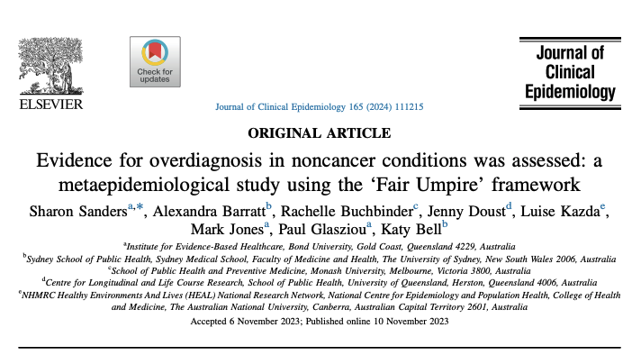
Overdiagnosis: a diagnosis that does not benefit the patient.
Fair Umpires: existence and extent of overdiagnosis may be considered using the following questions:
Are people diagnosed by diagnostic strategy 2 but not by diagnostic strategy 1 at an increased risk of disease specific clinical outcomes if left untreated compared to people not diagnosable by diagnostic strategy 1 or 2 (prognosis evidence)?
Does diagnosis and treatment of people who are detected using diagnostic strategy 2 but not detected using diagnostic strategy 1 result in an increased beneficial reduction in disease specific clinical outcomes that outweighs the ensuing increased risk of harms, compared to no diagnosis or treatment (utility evidence)?

Slide 28
Credit to the crew
Intermountain Research
Sam Brown MD MSCI
Ithan Peltan MD MSc
Holly Frost MD PhD
U of U DBMI
Joseph Finkelstein MD PhD
Ramkiran Gouripeddi MBBS MSc
U of U PCCM
Barb Jones MD MSCI
Jeanette Brown MD PhD
Rob Paine MD
Dustin Anderson-Bell MD
U of U Medical Machine Intelligence Lab
Warren Pettine MD
Matthias Christensen PhD
U of U Epidemiology
Benjamin Brintz PhD
U of CA Davis PCCM
Krishna Sundar MD
Email: brian.locke@imail.org

